Slide 1

CI Connections

Slide 2
CI: The Glory Days
Build/CI
Server
Developer
VCS
Tester
Notification
System

Slide 3
CI: Today
Staging
Env.
Issue
Tracking
Code
Analysis
?
Binary
Artifact
Store
Performance
Env.
Build/CI
Complexity
Stress
Env.
Integration
Env.
Test
Executor

Slide 4
CI: Over the Barrier
Staging, NFT, Pre-Prod, etc. Envs.
  Less and less Mocked Environments
  Integration and Functional Testing
  Nasty bugs can be Caught Here
Performance, Stress Test Env.
  Usually Special Treatment Required.
  Can Validate/Invalidate the Entire Architecture

Slide 5
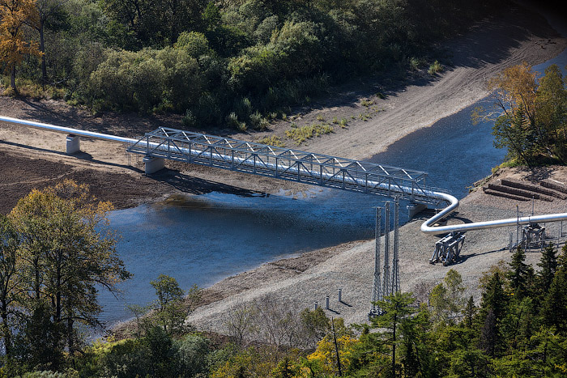
Barriers

Slide 6
Barriers: Source of Complexity
Costs
  More Hardware to Upkeep
  More People on Maintenance
Scaling Out
  Keep more than one QA Environments
  Growing Number of Deployable Units
  Growing Number of Test Executors
  Collect and set up all the Dependent Services

Slide 7
Barriers: Conclusions
Configuration
  Deliver Configuration as part of the Product
  (Deliver Containers)
  Prepare a good Naming Convention
  Say 'No' to Insane Modularization
Plan with the Costs
  Complex CI is not Cheap, even if Automated
  It is not too far from Continuous Delivery

Slide 8
CI: Tomorrow?
Integration
Env.
Staging
Env.
Pre-Prod
Env.
?
Build/CI
Complexity
Stress
Env.
Performance
Env.

Slide 9
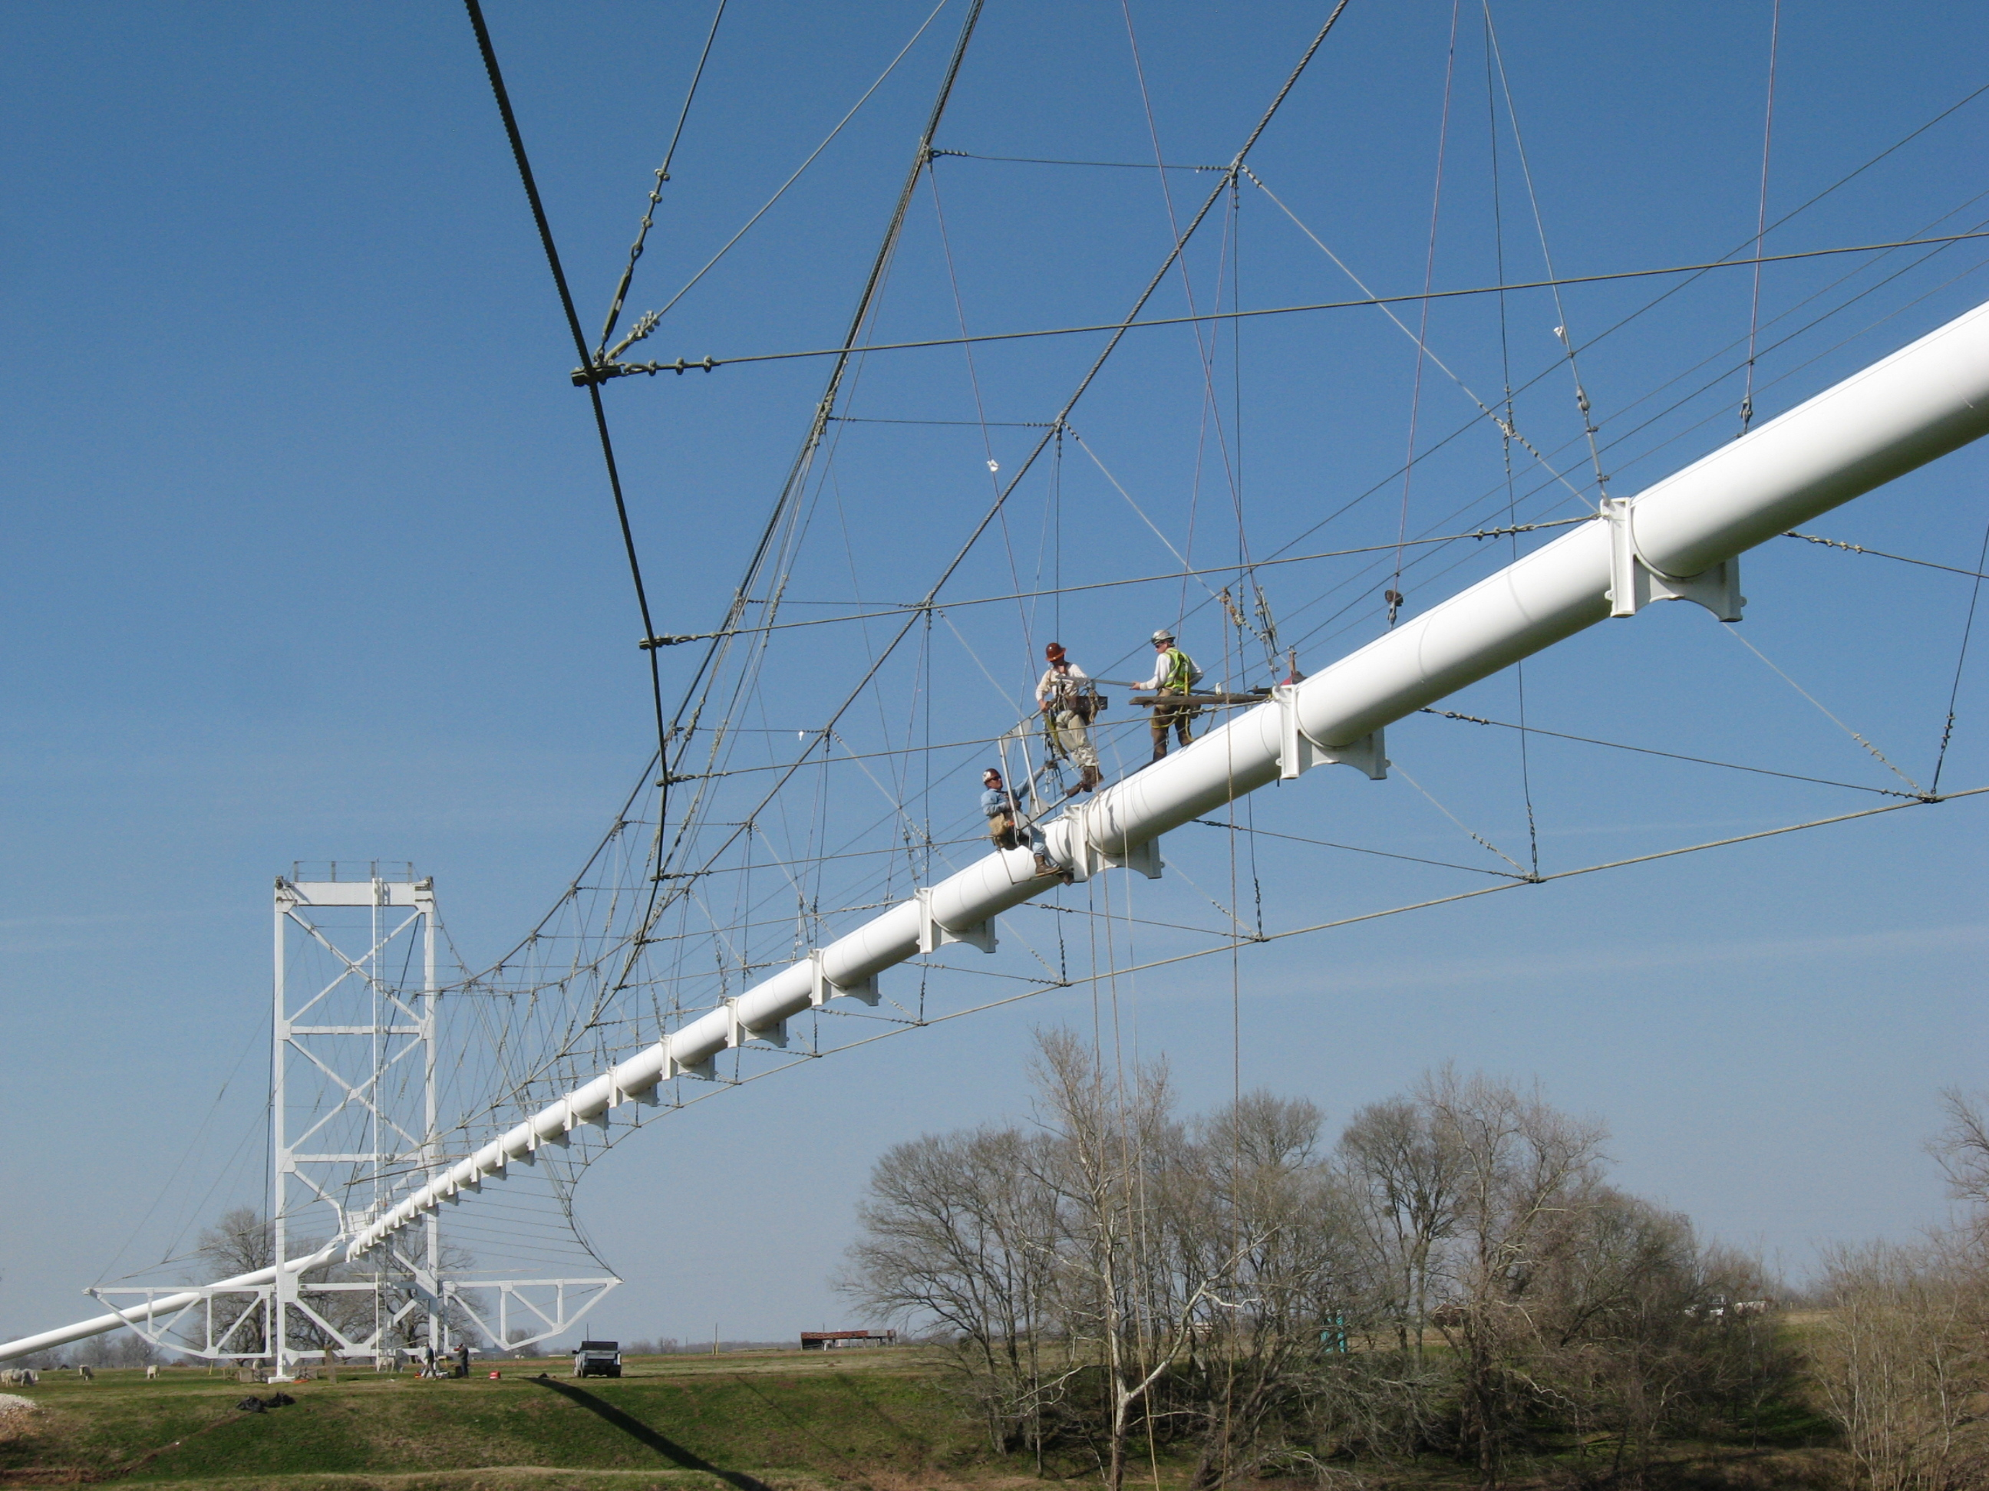
Questions?

Slide 10
Thanks for your Attention!
Kishalmi László
laszlo_kishalmi@epam.com

